Slide 1
Backup & Restore Databases
+
Security & User Management
C7 - Week 2

Slide 2
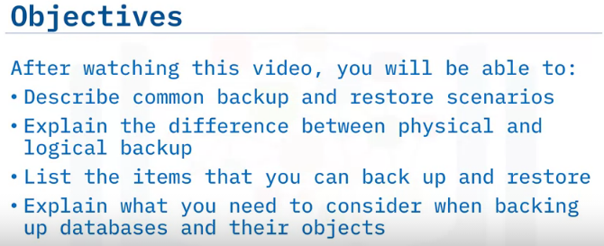
Introduction to Backup & Restore Databases

Slide 3
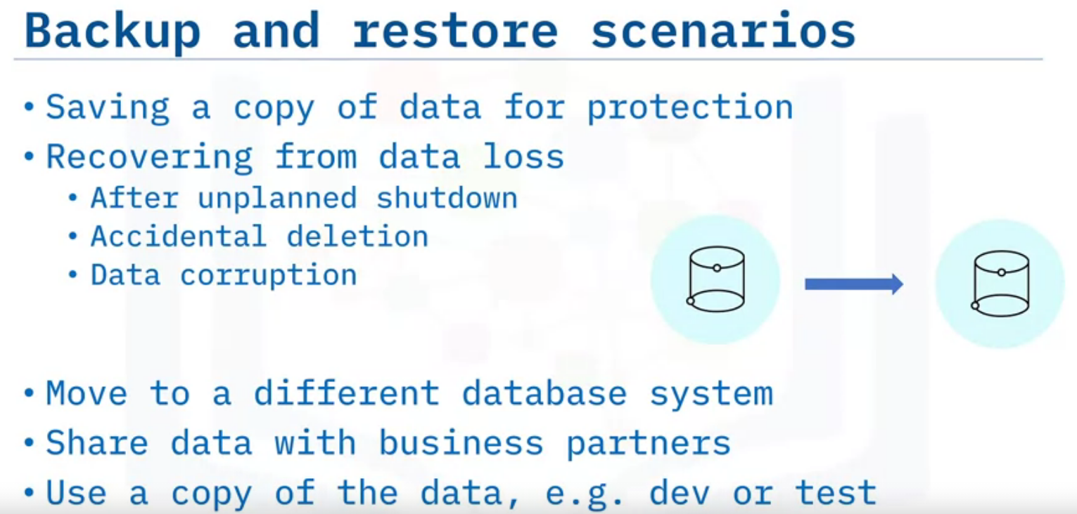

Slide 4
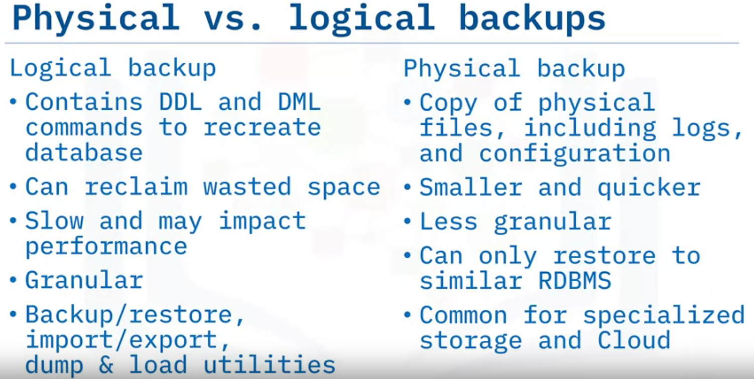
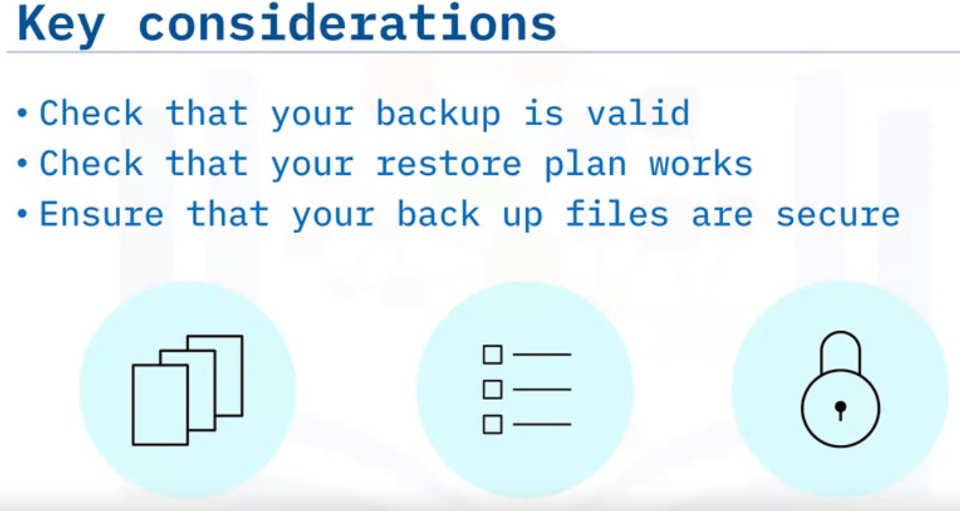
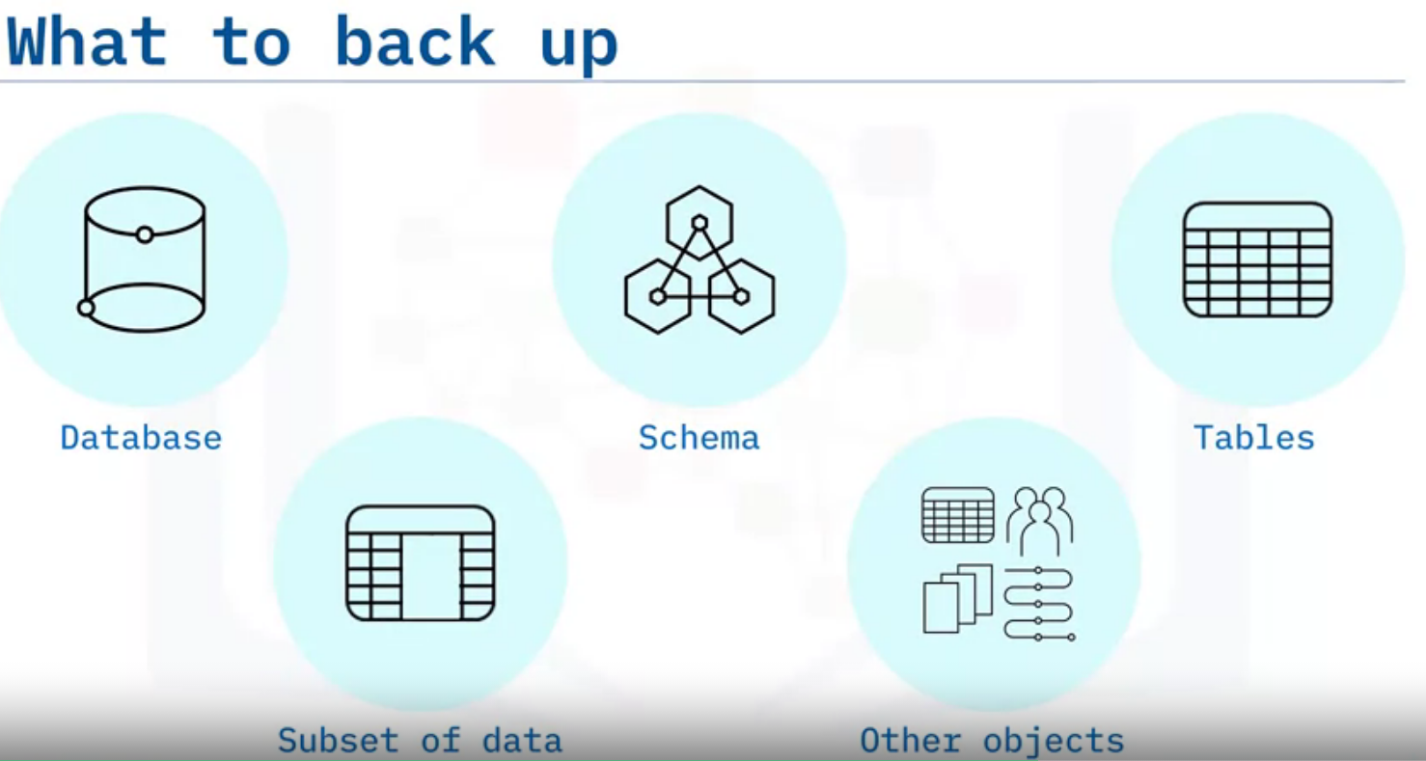
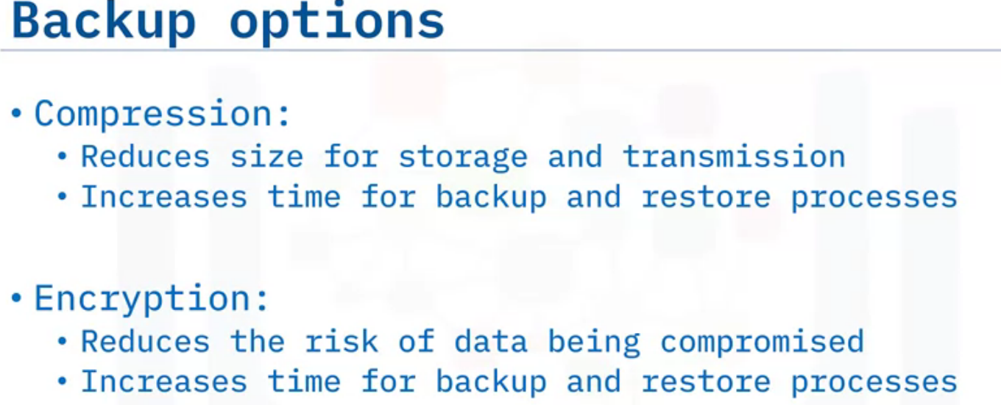

Slide 5
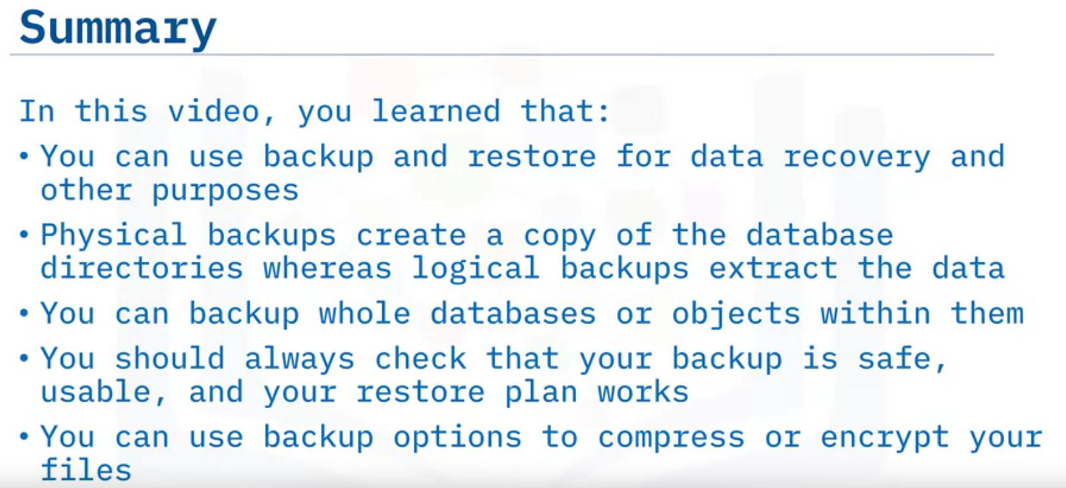

Slide 6
Types of Backup
Full Backup
Point-in-time Backup
Differential Backup
Incremental Backup

Slide 7
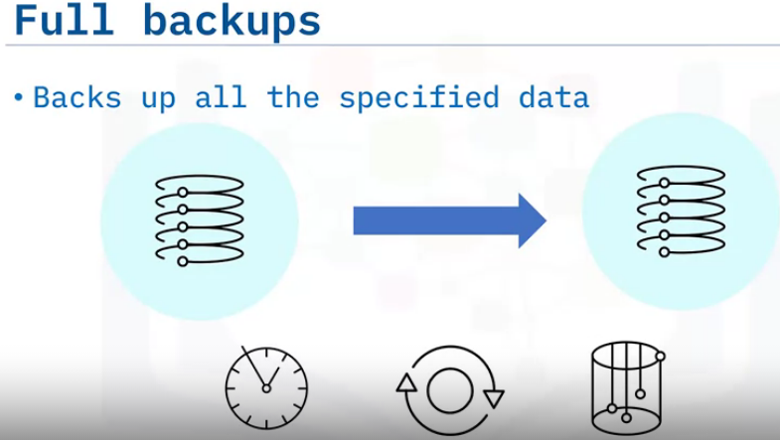
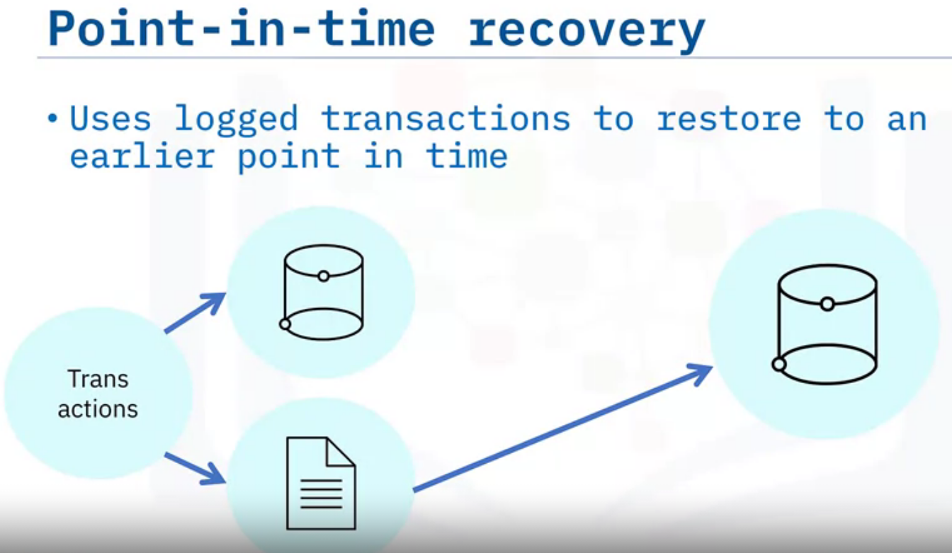
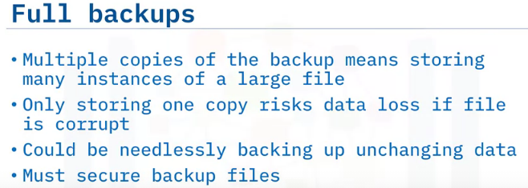
When you restore a full backup, you restore the data to the state that it was in when the backup was taken. But the database may have processed many transactions since that time, which should ideally be restored too.
One way around this issue is to enable logging of each transaction on your database and then you can use the information in the log file to reapply the transactions to the restore database.
The process of reapplying transactions after restoring a database backup is known as recovery and it enables you to recover the data to a state that it was in at a particular point in time, hence the name, point-in-time recovery.
For example, if you know that a DML statement run at 11:05am erroneously deleted some data, you can restore the latest full backup and then reapply the transactions up to that point in time, minimizing the loss of data changes that occurred between the last full backup and the moment that the wrong data was deleted.
Different database systems use different terminology for the log containing the transaction information, or example, MySQL calls it the binary log, Postgres calls it the write-ahead log, and Db2 on Cloud calls it the transaction log.
Copies all the data, we just need to relocate the backup file.
Takes more time, bandwidth and storage space.

Slide 8
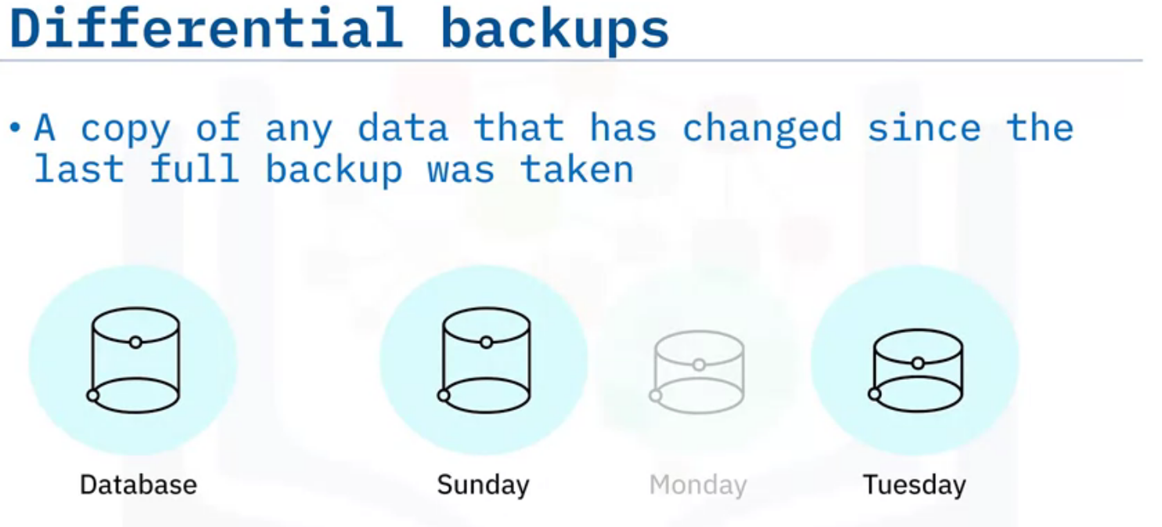
Because full backups can require a lot of time, bandwidth, and storage, one alternative is to use them in conjunction with differential backups.
A differential backup consists of a copy of any data that has changed since the last full backup was taken. This makes the differential backup file much smaller than a full backup file, reducing the time, bandwidth, and storage needs for the backup while still enabling you to restore a recent copy of the data.
For example, you could perform a full backup once a week on a Sunday and then run a differential backup every day of the week. Each differential backup contains all the changes since the full backup was taken on the Sunday, so if you need to restore the database on a Tuesday, you first restore the full backup from Sunday and then restore the differential backup from Tuesday.
You do not need to restore Monday’s differential backup, because all the changes in that file are also included in the differential backup from Tuesday.
Restoring data from full and differential backups will take longer than simply restoring a full backup, but because you restore data less frequently than you back it up, you are likely to save time overall.

Slide 9
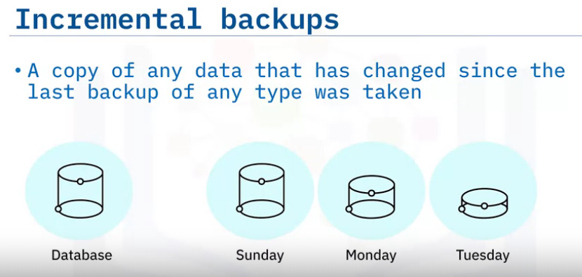
Incremental backups are similar to differential backups, but they only contain data that has changed since the last backup of any type was taken.
For example, you could perform a full backup once a week on a Sunday and then run an incremental backup every day of the week.
Each incremental backup only contains changes since the backup was taken on the previous day, so if you need to restore the database on a Tuesday, you first restore the full backup from Sunday, then the incremental backup from Monday, and then the incremental backup from Tuesday.
Restoring data from full and incremental backups will take longer than simply restoring a full backup or restoring differential backups, but the time taken to perform the incremental backups is likely to be less than needed for a differential backup.

Slide 10
Backup Policies

Slide 11
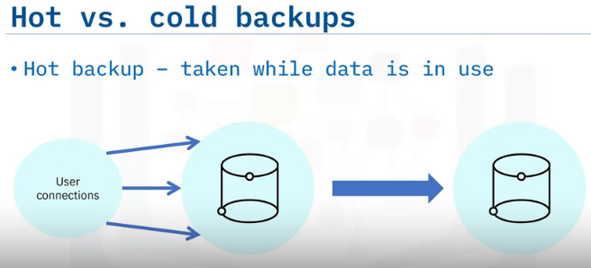
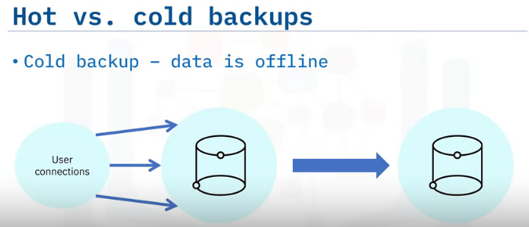
Hot Backup
Hot backups, or online backups, are those performed on data when it is in use.
The advantage of hot backups is that they have no impact on availability and users can continue with their activities throughout the backup period.
However, hot backups can result in performance degradation for users while the backup is running and can impact on data integrity if data changes during the backup process.
Cold Backup
The alternative to hot backups is to take the database offline while the backup is run. This is known as a cold, or offline, backups.
This eliminates the data integrity risks associated with hot backups, but has a greater impact on user availability and cannot be used in 24/7 environments.
Hot backups are generally stored on an available server and often receive regular updates from the production database.
This enables them to be brought online should the production server fail, to ensure continuing availability to users.
Cold backups tend to be stored on external drives or on servers that are shut down between back up operations.
This can provide greater data safety, but does mean that the recovery process will take longer than that of a hot backup.

Slide 12
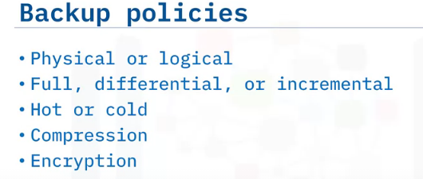
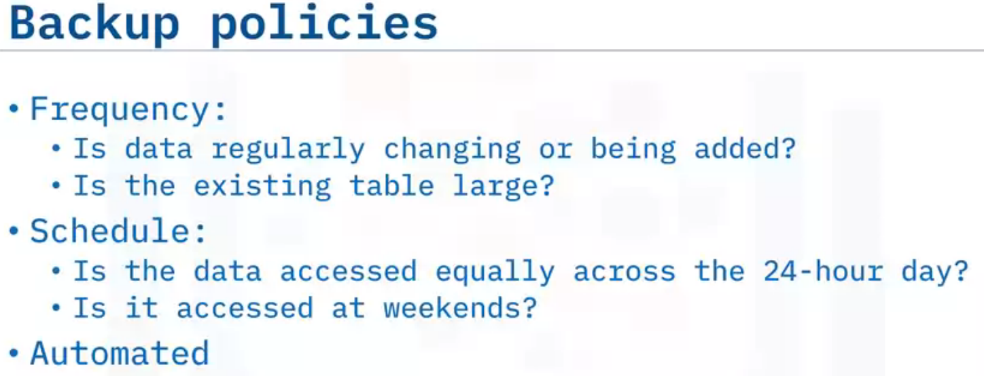
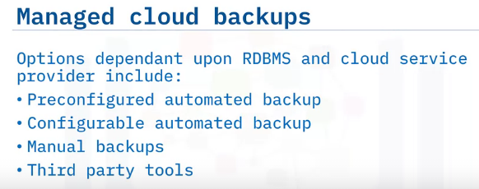
how to implement your backup and restore policy: physical or logical backups, type of backup, hot or cold backup, compression, and encryption.
You also need to consider how often you need to back up your data. This is dependent on the impact that any data loss would have on your business operations and how frequently your data is changing.
For example, a table containing product information is likely to change less frequently than a table containing customer orders, so you could back that up less regularly than the orders table.
But if your orders table already contains a large amount of data, you won’t want to be performing frequent full backups, so should consider using differential or incremental backups for it.
You also need to consider when to perform your backups. If your data is mainly accessed during the working day in one time zone, you should schedule your backup outside of those hours.
However, if it is accessed across the whole day, you could consider implementing full backups at a weekend and incremental or differential backups on a daily basis. Because backups will be a regular task, if your RDBMS provides the ability to schedule or automate your backups, you should consider using it.
It is equally important to consider backing up your cloud databases. Depending on the RDBMS that you are using, backups might run automatically, you may need to enable automated backups, you may need to run manual backups, or you may be able to use the techniques you have learned about in this video to run your own backup strategy.
For example, the paid plans of Db2 on Cloud run an encrypted backup every day and with the Enterprise or Standard plans, you can also run manual backups and perform point-in-time restores.
And when using Google Cloud SQL for MySQL, Postgres, and SQL Server, you can enable automated incremental backups or perform on-demand backups.
If you find that your combination of RDBMS and cloud provider does not support any of these options, there are third party backup tools available to purchase.

Slide 13
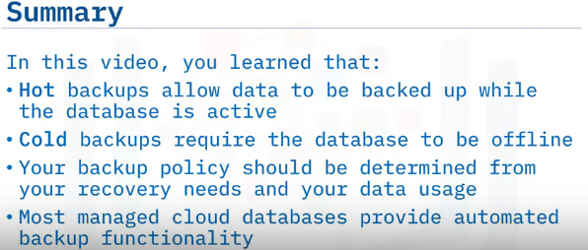

Slide 14
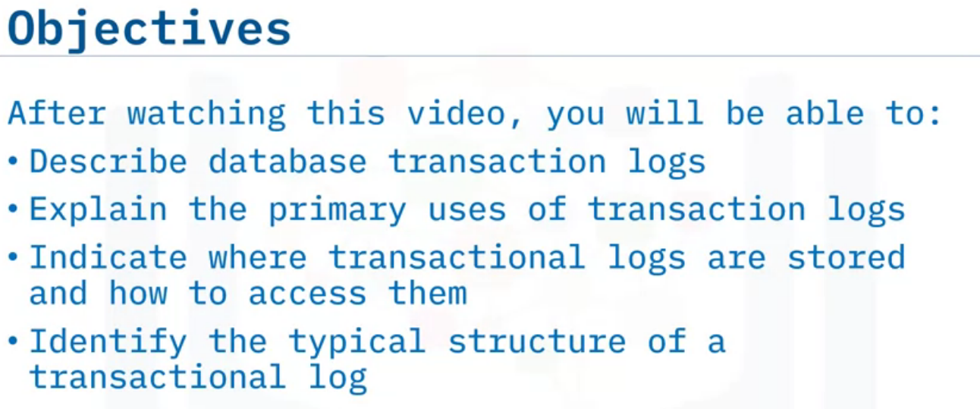
Database Transaction Logs

Slide 15
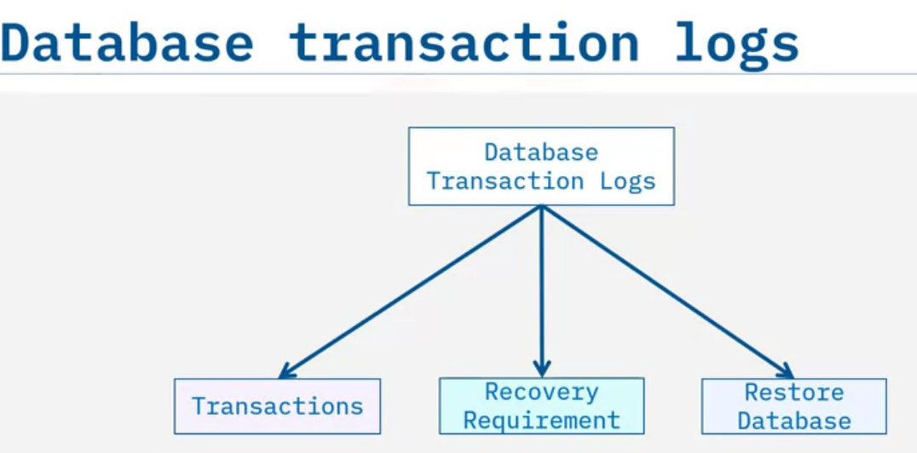
Separate from the diagnostic log, a database management system (DBMS) uses transaction logs to keep track of all transactions that change or modify the database.
The information stored in these transaction logs can be used for recovery purposes when data is accidentally deleted, or a system or hardware failure such as a disk crash occurs.
In case of such events, the transaction log, in conjunction with a database backup, can help restore your database back to a consistent state at a specific point in time.

Slide 16
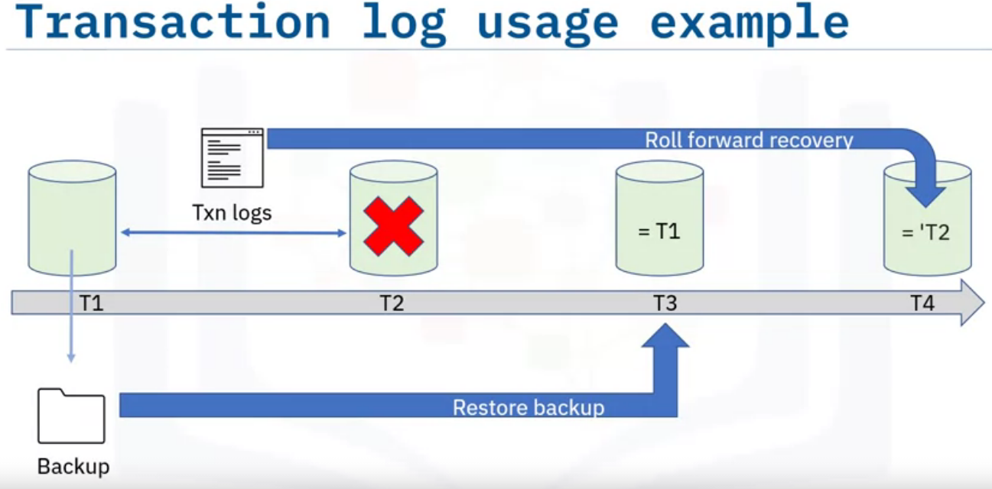
For example:​
In this timeline, at time T1 you issue the BACKUP command to make a full copy of your database.
Users then continue working, and the information about their activities is kept in transaction logs.
At time T2, there is a problem that damages the database. So, at time T3 you issue a RESTORE command using the backup image you took at time T1.
This allows you to get the database back to the point in time that the backup was taken.
Then, at time T4 you apply the transaction logs for the period of time between T1 and T2 to the restored database.
This process of applying committed transactions from transaction logs is called roll forward recovery, and it returns your database to the point just before the crash happened.

Slide 17
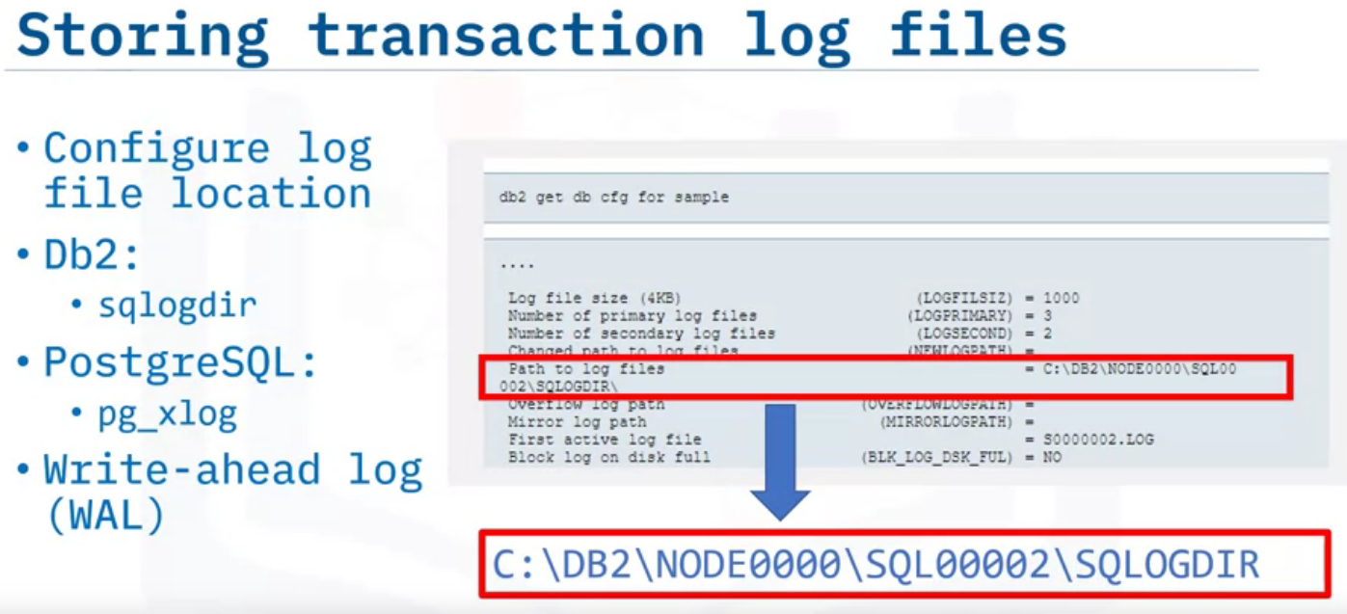
Here is an example location of a db2 transaction log file directory in a sqlogdir subdirectory on a Windows system.
In PostgreSQL, the log files default to being stored in the pg_xlog sub-directory.
In PostgreSQL, the transaction log file is referred to as a write-ahead log (WAL), because before the database manager writes the database changes or transactions to data files, the DBMS first writes them to the WAL.

Slide 18
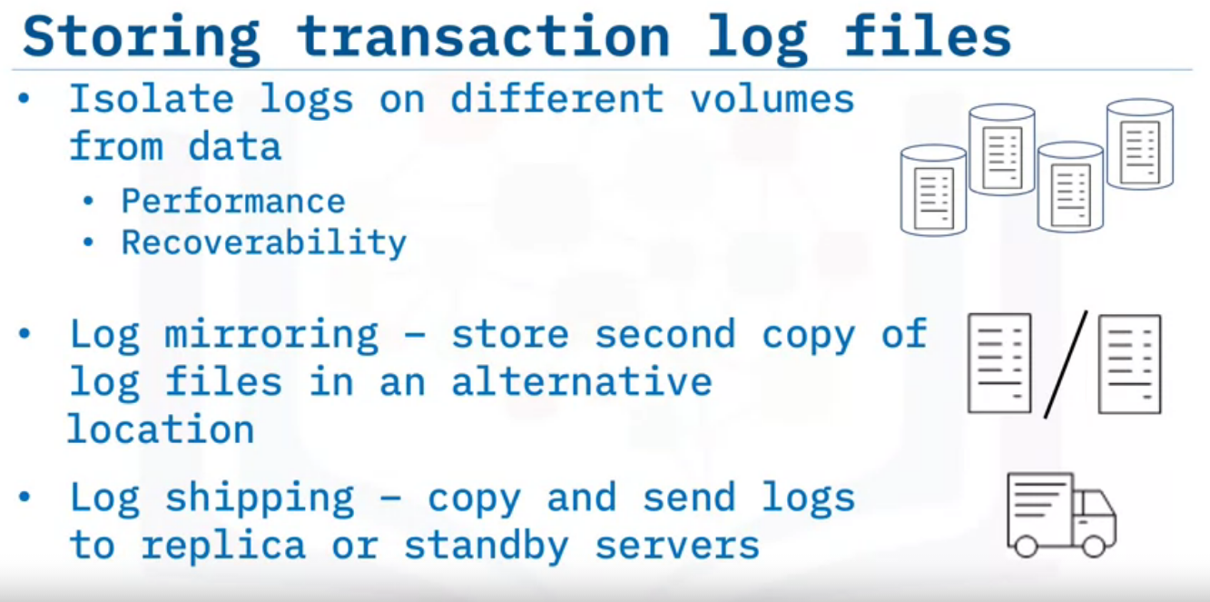
A recommended best practice, at least for production databases, is to place the transaction log files on storage volumes that are separate from where the database objects like tablespaces are stored.
This not only helps with performance, so database writes are not competing with log writes, but also improves recoverability since it isolates logs from crashes or the corruption of data volumes.
For even more enhanced recoverability in business-critical databases, some relational database management systems (RDBMSs) provide the ability to automatically mirror logs to a second set of storage devices.
Or you can write scripts to copy or ship logs to remote replicas or standby systems in a process called log shipping.

Slide 19
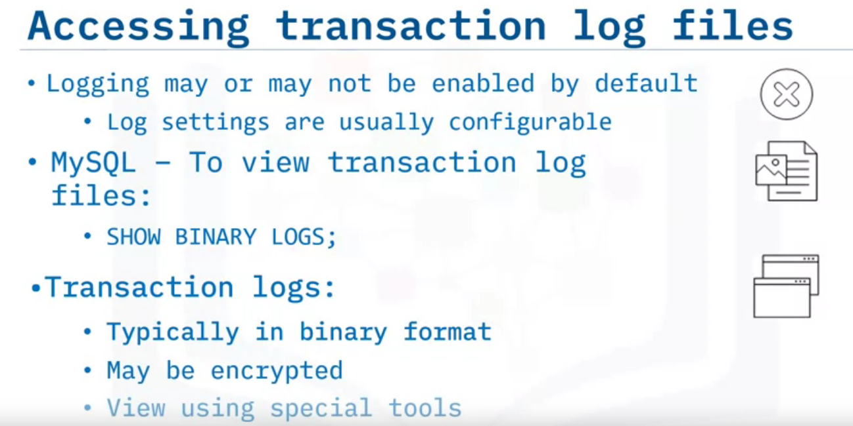
In many RDBMSs, like Db2 and SQL Server, transaction logging is enabled by default, but you still may want to change the default settings for improved recoverability and performance.
In other RDBMSs, like MySQL, transaction logging is disabled by default and may need to be manually configured.
For MySQL, you can run the SHOW BINARY LOGS command to check if logging is enabled and if it is, you will see a list of the log files.
Unlike other types of logs, such as diagnostic and error logs that are mostly in text format and human readable, the database transaction logs are typically in binary formats that are sometimes encrypted and require specialized tools to format and display contents.

Slide 20
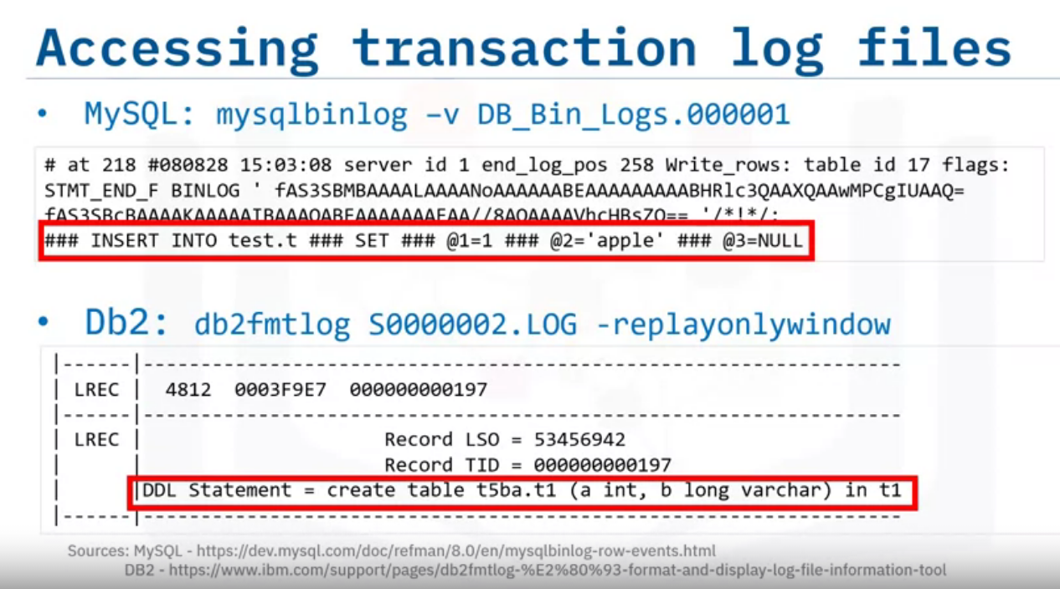
For example, in MySQL, you use the mysqlbinlog tool to view the contents of MySQL transaction log files, also known as binary logs.
The sample output shows a log file entry for an INSERT statement.
And for Db2, you use the db2fmtlog tool for formatting and displaying log file information.
The sample output shows a record for a DDL statement to create a table.

Slide 21
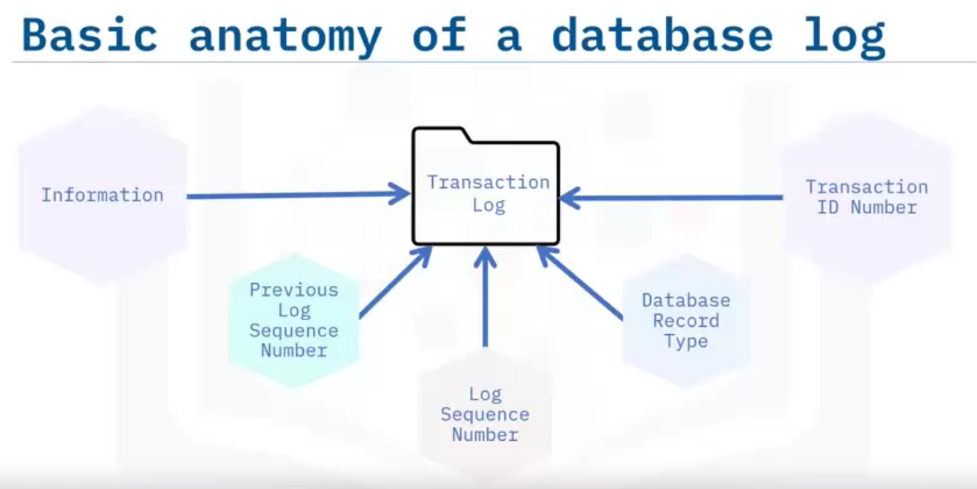
A log file contains multiple entries, and the information they contain may vary depending on the RDBMS.
For example, a typical database log record is made up of:
A log transaction ID number, which is a unique ID for the log record.
The database record type, which describes the type of database log record.
A log sequence number, which is a reference to the database transaction generating the log record.
A previous log sequence number is a link to the last log record.
This implies that database logs are constructed in linked list form.
And information which details the actual changes that triggered the log record to be written.

Slide 22
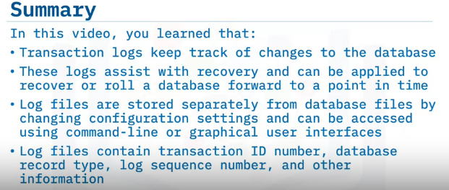

Slide 23
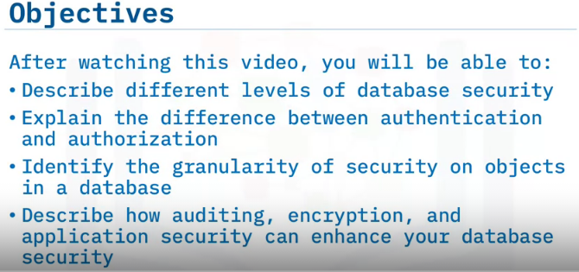
Security & User Management

Slide 24
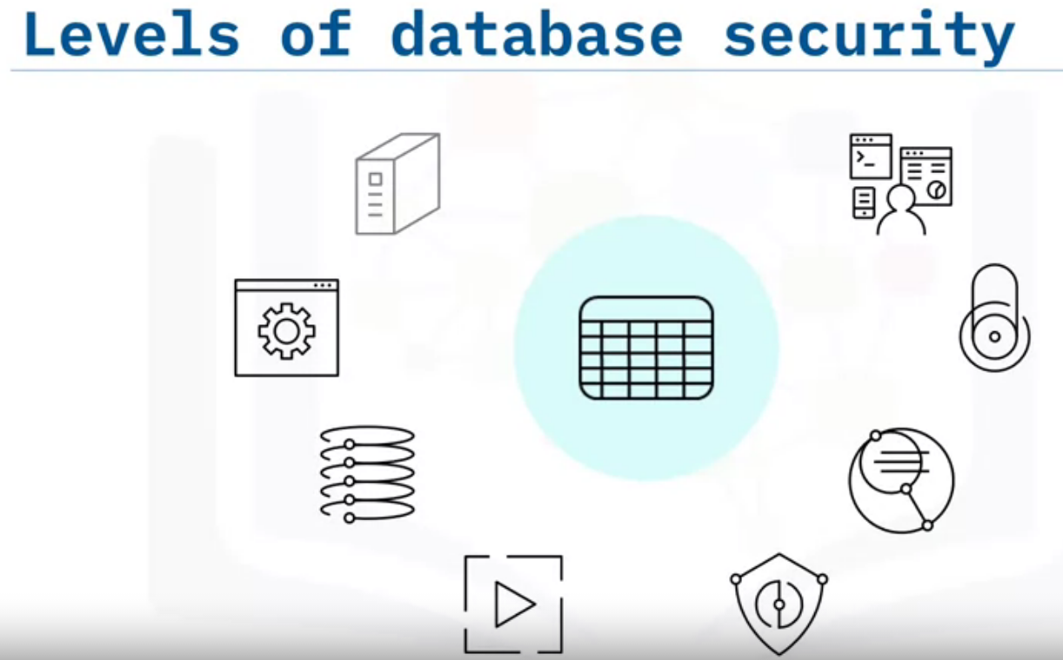
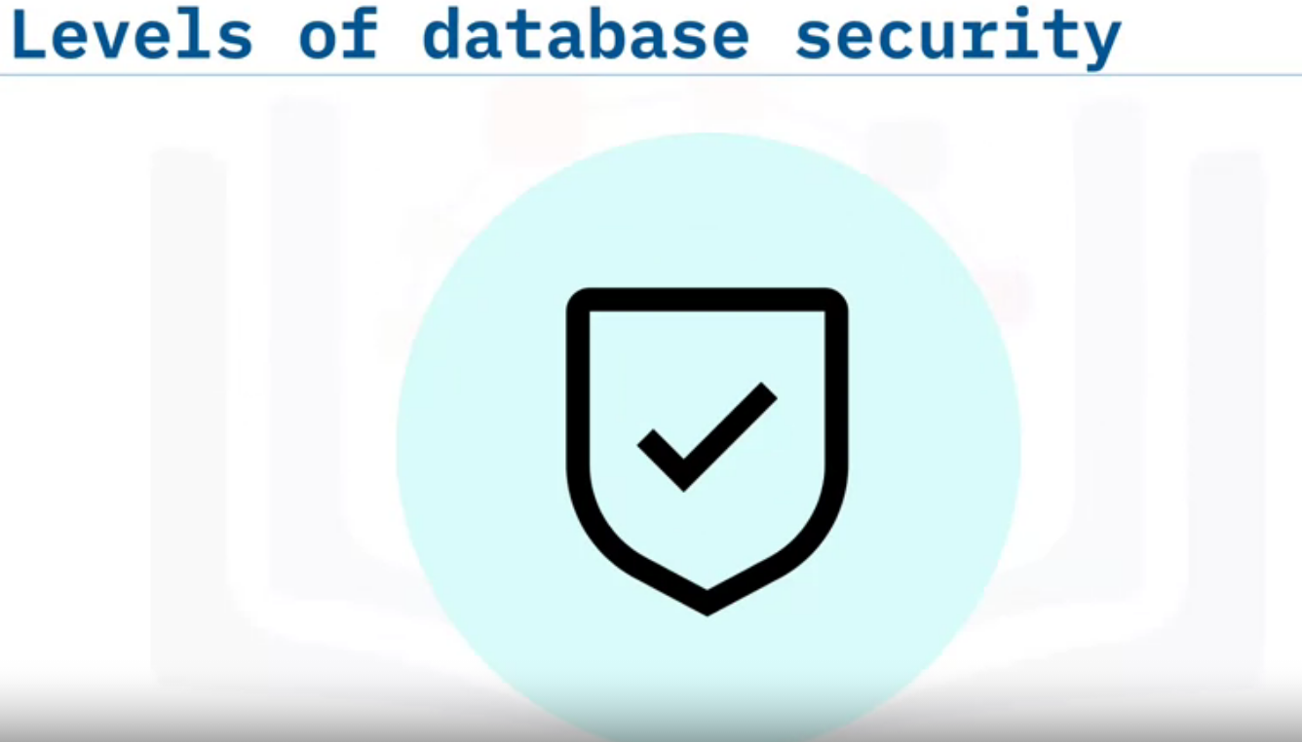
Ensuring the security of the data stored in your systems is
an essential part of the database management role.
It involves identifying the potential risks to your data
and mitigating those risks by applying security measures and controls at all levels of a system.
Even though the actual implementation of the measures at some levels may not be your direct responsibility,
it is imperative that you evaluate that they are adequate for the data you store or access there

Slide 25
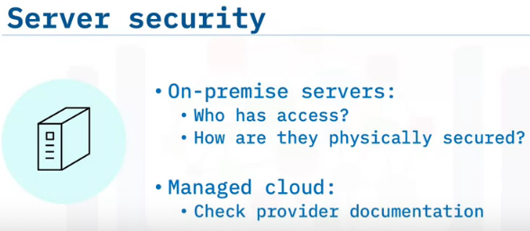
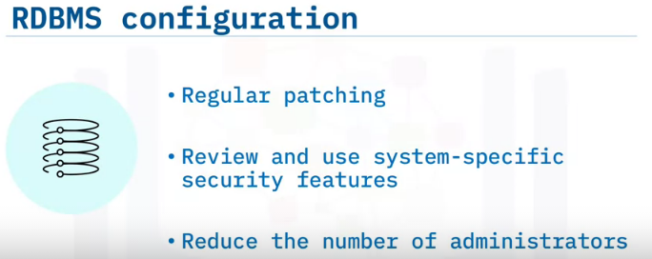
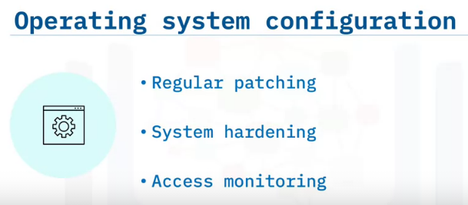
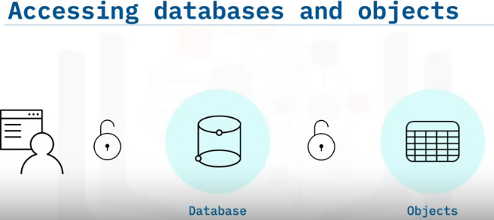
Firstly, you need to make sure that the actual servers in your system are physically secure. For on-premise servers, you should assess who has access to server location and the security measures in place.
If you are using a managed cloud environment, your provider will be responsible for the security at this level.
Next, you should consider the operating system hosting your database. You should ensure that it is regularly patched with the latest tested updates, that it is hardened using a known configuration to reduce vulnerabilities, and that it is continuously monitored for any unauthorized access.
You should take similar measures on your RDBMS to those for your operating system. You should regularly apply the latest tested updates,
you should review and use all security features and configuration options available in the system, and you should ensure that only a small set of trusted users have administrative privileges.
Users and client applications need to be permitted to access a server or database and the objects in it.
Firstly, users need to be authenticated on the server or database to enable them to access it.
And then they need to be granted permissions on individual objects, or groups of objects,
in the database to interact with them

Slide 26
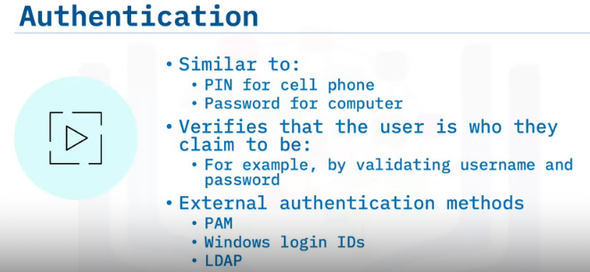
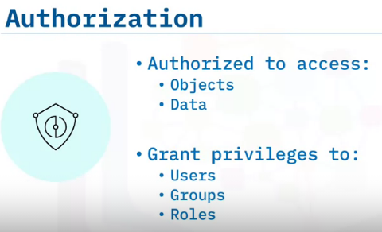
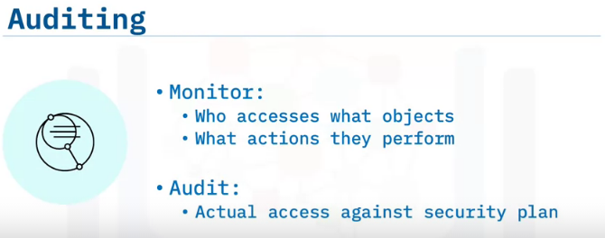
Pluggable Authentication Module
Lightweight Directory Access Protocol (LDAP) or Kerberos.
Authentication is done for user verification Whereas, Authorization is done for assigning permission/privileges to access secured data.
Assigning privileges will vary depending on the object you are working with. For example, on a table you can allow users to select, insert,update, or delete data, or to alter the structure of the table. In some RDBMSs, you can narrow this down even further to assign privileges on a columnar basis.
You should always use the principle of least privilege, that is, only allow users to access the least amount of data that they need to succeed in their tasks.
In addition to restricting users to only access the information and objects that their role requires, you should also consider monitoring and auditing database activity. You should track which users access a server or database and the actions that they perform. Analyzing this information against your security plan can alert you to gaps in it.

Slide 27
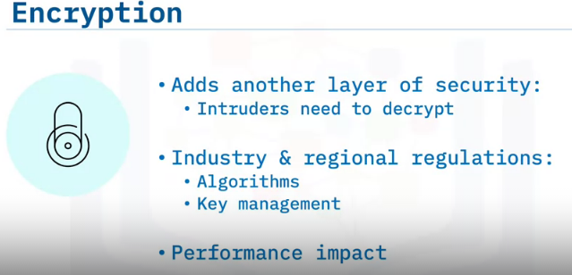
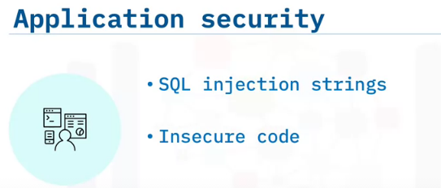
you could consider using encryption to add another layer to your security system.
Then if an intruder does manage to access the data, they also have to decrypt the data to make any use of it.
Certain industry regulations and regions legislate the use of specific levels of encryption for sensitive data.
It is important to check such regulations for algorithm and key management requirements when planning your database security.
Do remember though, that encrypting and decrypting data can be a time and resource intensive operation, so you will need to consider the impact this will have on your operations and whether you need to upgrade your hardware accordingly.
Even the most secure combination of operating system and RDBMS can be compromised by lax application security such as SQL injection strings and insecure code.
Therefore, it is important that you test and monitor the security of any applications interacting with your data and databases.

Slide 28
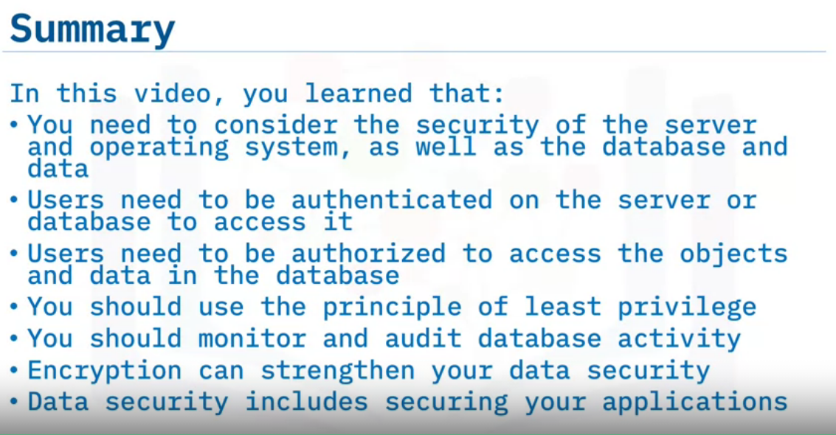

Slide 29
Users, Groups & Roles
Objectives: Explain Users, Groups & Roles and How they work together

Slide 30
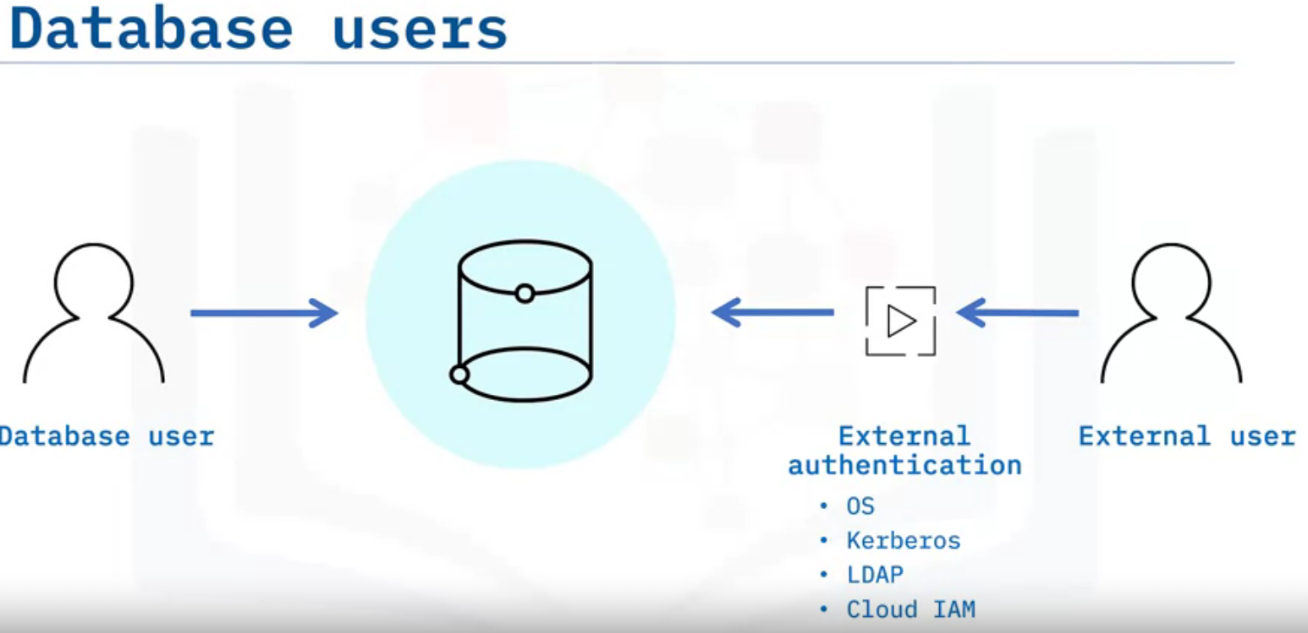
Internal Vs External
Identity management Services
A database user is a user account that is allowed to access specified database objects. Depending on the DBMS and your security policies, a user might be explicitly created and authenticated within the database system, or may be created externally and authenticated using external authentication such as the operating system or external identity management services like Kerberos, LDAP, and Cloud IAM.

Slide 31
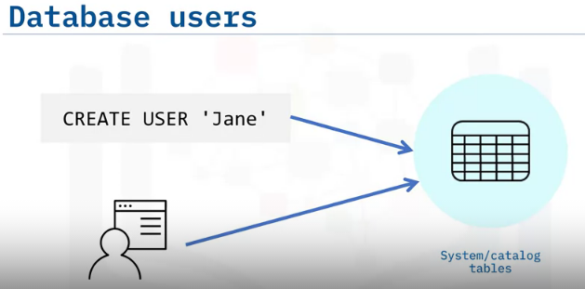
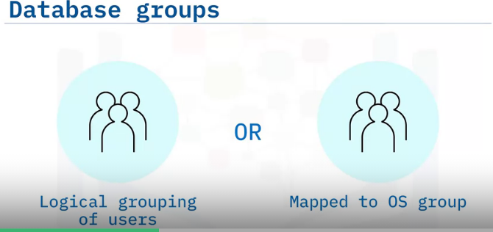
When you first create a user, they will generally have few, if any, permissions to actually interact with the database objects unless they are the creator of the database.
User names are stored in system tables or catalog tables which you should not try to edit directly.
Some RDBMSs support the concept of user groups.
In some cases, such as Postgres, you define groups in the database and they are logical groupings of users to simplify user management.
In other systems, such as SQL Server and Db2, you can map a database group to an administrative group in the underlying operating system.
This is particularly useful when you are using that operating system to authenticate your users.
Similarly, if you are running your database on Amazon Relational Database Service (Amazon RDS) for example, you can use virtual private cloud (VPC) security groups and database (DB) security groups to manage your user access.

Slide 32
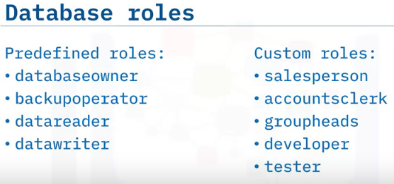
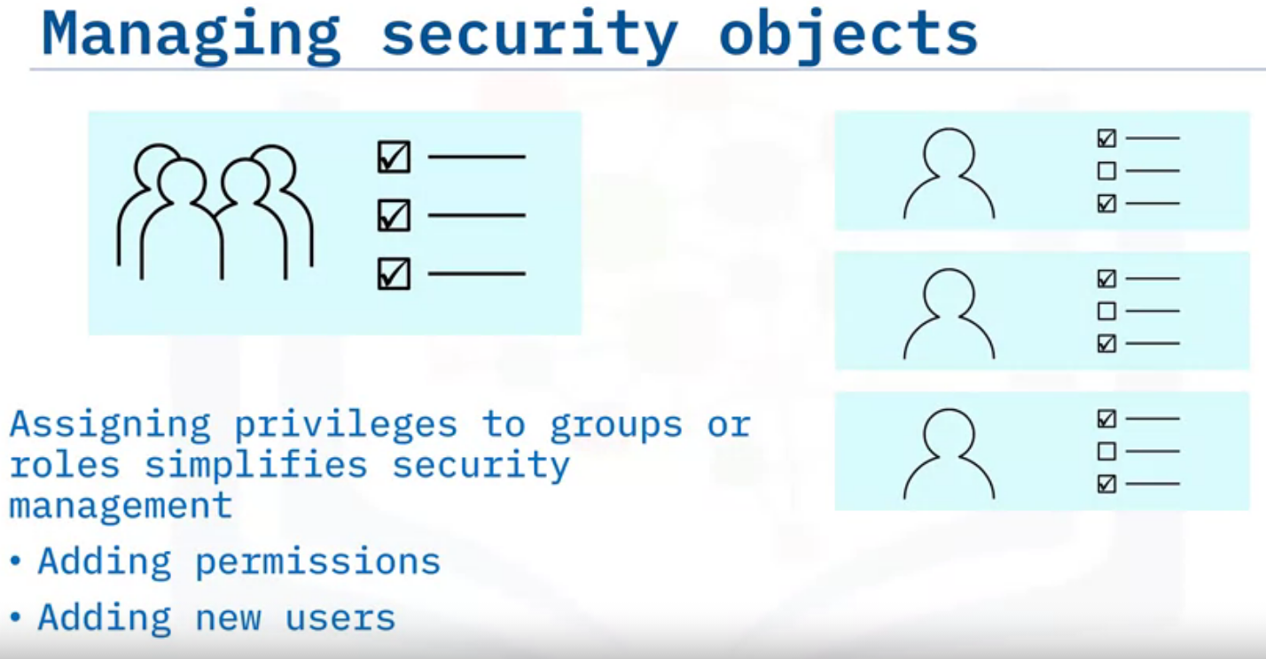
Database roles are similar to database groups in that they confer privileges and access rights to all users of that role.
A database role defines a set of permissions needed to undertake a specific role in the database.
For example, a backup operator role would have permissions to access a database and to perform backup functions.
Some RDBMSs have a set of predefined roles that you can use for your users, such as a database owner or backup operator role.
And most enable you to create your own roles, so you might create a salesperson role that has the permissions a salesperson will need on the relevant tables in the database.
Assigning privileges to groups or roles, rather than individual users, greatly simplifies your security management tasks.
If you know that a set of users all need access to the same functionality to fulfill their job role, you can put those users in one group and assign the relevant permissions to the group.
If that job role changes in the future, it is quicker, easier, and less prone to mistakes to just add the new permissions to the group rather than individual users.
Similarly, if a new member of staff joins the team, you can simply add them to the role or group, rather than having to assign all the separate permissions to them.
One user can be a member of one or more roles. So the head of the sales group could be a member of the group heads role and the salesperson role.

Slide 33
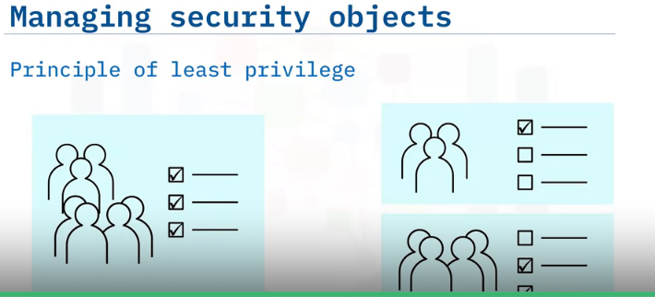
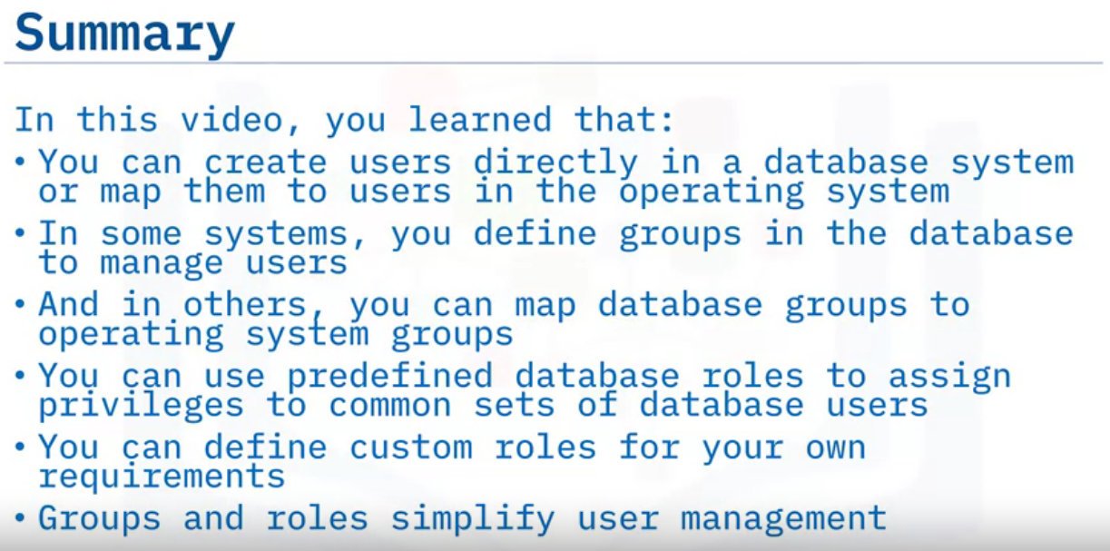
When implementing role or group membership, remember to use the principle of least privilege:
only adding users to groups they need to be a member of, and ensuring that your roles don’t include any permissions that the majority of the users in them will not need.
In the latter scenario, you should reassess your role permissions and create multiple, more granular, roles or groups.

Slide 34
Managing Access to Databases & their Objects
Objectives: Grant, Revoke & Deny access to objects in a database

Slide 35
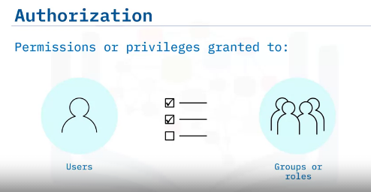
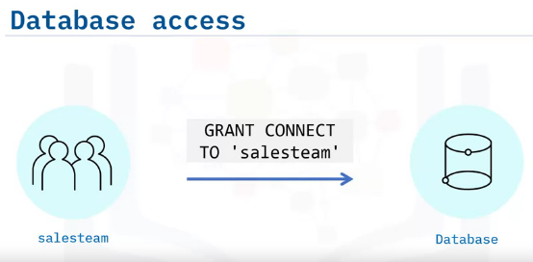
After a user is authenticated on a database, they need permissions or privileges to access the objects and data in that database.
Privileges are granted to users, and to groups or roles. The combination of a user’s own personal permissions and those of the groups or roles they belong to defines their overall permissions.
In systems where users are authenticated outside the database (such as on the operating system or through an external plugin), you may also need to grant them access to the databases they will be working with.
You can use the SQL GRANT CONNECT command to grant connection access to a particular database to a particular user, group, or role.
In case of an individual user named Rock, we can spacify it as ‘ GRANT CONNECT TO ‘Rock’

Slide 36
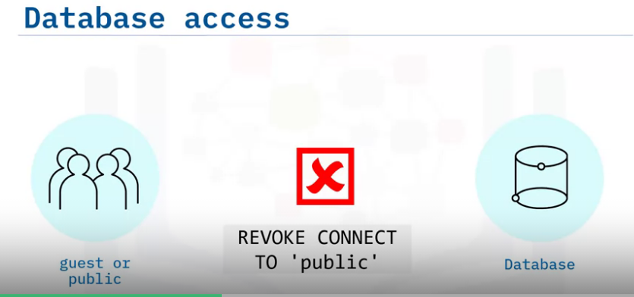

If your RDBMS provides a guest or public account, you may find that by default it has connect privileges to all databases.
In this scenario it is a good practice to revoke that permission so that you ensure only users given explicit permission can access your data.
You use the SQL GRANT command to grant privileges on tables in a database.
In this example, the salesteam group is granted select privileges on the mytable table in the mydb database.
You can use similar statements to enable users to insert, update, and delete data by granting them the relevant privileges on a table or tables.
To provide these privileges to an individual user, just replace the salesteam group name with the name of that user.

Slide 37


you can also use the GRANT statement to grant privileges to create objects in a database.
This example shows how to enable a group or role to create a table.
And again, you can use a similar statement to enable a user to create an object such as a table or stored procedure.
On a procedure or function, you can permit a user or group to view the code. This means that they can view the definition of that function or procedure, but they will not be able to run it or change it.
To run the code, a user needs the execute permission. And to change the definition of a procedure, a user needs the alter permission.

Slide 38


You can use the revoke statement to remove granted privileges, and most RDBMSs will also provide revoke functionality in the user interface.
However, because an individual’s privileges are a combination of those granted to all the groups or roles they belong to, a member of the sales team role may still be able to access this table through their membership of another role.
If you want to ensure that users do not have permission for a certain object or action, you can use the deny statement to override any previous grant of that permission.

Slide 39
Auditing Database Activity
Objectives:
Why Auditing is important?
How to Audit Database access?
How to Audit database activity?

Slide 40



If an unauthorized user accesses your database, they have already overcome one or more of the levels of security in your system.
Therefore, it is imperative that you track who accesses your database and review the information to identify any unauthorized users.
You should also track failed attempts to access the database, as these can help you to identify potential attacks, such as brute force attempts, on your system.
Most database systems provide functionality that you can use to audit database access.
For example, in Db2 on Cloud you can use the user validation category of the built-in audit facility to log user authentication events.

Slide 41

Sometimes authorized users may find that they can view and edit data that they should not have permissions on.
If you track all user activity, you can then use the output reports to review which users are accessing which tables and check whether those actions match your security plans.
To audit database activity, some RDBMSs use triggers. These are special stored procedures that automatically log the activity after a DML statement event, such as an insert, occurs.
Other systems enable you to attach actions to the events that occur in the database.
In Db2 on Cloud you can use the change history event monitor to enable auditing on specific tables or objects.
In Postgres you can use the downloadable pgAudit tool to log individual action types or all actions in a database.
You should ensure that whatever auditing implementation you use meets the compliance requirements of your customer or region.

Slide 42


Slide 43

Encrypting Data

Slide 44


Data encryption provides yet another layer in your security system and is often the last line of defense if data is compromised.
it can help to protect your data at rest and during transmission.
Some industries (such as financial and medical services), regions, or specific customers may also require that you encrypt certain types of data.
For example, the Payment Card Industry Data Security Standard (PCI DSS) requires that all companies that process, transmit, or store credit card information encrypt that data.
“At rest data” refers to your data when it is stored, or at rest, in your RDBMS.
It is important to encrypt data at rest to ensure that malicious users cannot directly access the data files, bypassing your database security measures.
Some RDBMSs provide database-level encryption for the entire database. This is often termed transparent data encryption, or TDE.
Some provide table or tablespace encryption for individual tables. And some provide column level for maximum granularity and flexibility.
Do note though, that the flexibility that column level encryption provides is counteracted by performance degradation and complexity of set up.

Slide 45


You encrypt data by using an algorithm to change the data into an unreadable string, commonly known as ciphertext.
These algorithms use a key to ensure that anyone trying to decipher the text cannot do so without the key.
The simplest form of encryption is symmetric encryption, where the same key is used to encrypt and decrypt the data.
Mechanisms such as data encryption standard, or DES, and advanced encryption standard, or AES, use symmetric keys.
When using only one key, it must be shared between all parties wanting to access that data so that they can all decrypt it.
Sharing a key increases the likelihood of it being compromised and if the key to the encryption is compromised, your data is effectively compromised.

Slide 46


some databases use asymmetric encryption, also known as public key encryption.
This uses two keys: a public key and a private key, known as a key pair.
You encrypt the data with the public key and valid users have a unique matching private key to decrypt it.
Rivest-Shamir-Adleman (RSA) and elliptic curve cryptography (ECC) are both examples of asymmetric encryption.
Because asymmetric encryption involves the use of multiple private keys, it is essential that those keys are held securely.
Most modern databases take care of the complexity of encryption and key management for you.
Many of them support transparent data encryption, or TDE.
The “transparent” part of its name alludes to the fact that the encryption and decryption is not visible to your users.
The database engine encrypts the data before storing it and then decrypts it when an authorized user or application requests information.
Because the database engine is performing the encryption tasks, it also encrypts your database backups too.

Slide 47


Although TDE simplifies the process of encrypting your database, you may have concerns about storing data in the cloud and relinquishing the key management process to a third party.
Some cloud databases support customer managed keys, also known as the Bring Your Own Key (or BYOK) protocol.
This provides a separation of responsibility, so that your cloud database system is responsible for the encryption process, but you retain control of the keys that it uses.
BYOK provides an extra level of protection by ensuring that the cloud platform storing and encrypting your data does not have access to the decryption keys, so it cannot access your confidential data.
It also enables your security admins to manage your corporate keys, while your database admins can continue to manage the data. And for businesses whose customers require regulatory compliance around key rotation and expiration, you have complete control over the keys and their lifecycle.
Some RDBMSs support both symmetric and asymmetric encryption and enable you to configure which to use.
Because of the time and effort that it takes the algorithm to process the data, any type of encryption and decryption will decrease the performance of your database.
Because asymmetric algorithms generally use longer keys, they tend to have a greater performance impact than symmetric algorithms.
Therefore, unless you specifically require asymmetric encryption, it is often best to use the symmetric algorithms such as AES and DES.
AES is the recommended method for the earlier PCI DSS credit card example.

Slide 48

encrypting data at rest, you should also consider encrypting it in transit, that is, when it is being transmitted across networks or the internet.
As with data at rest encryption, many RDBMSs provide this functionality for you.
Some cloud databases encrypt data in transit using transport layer security (or TLS) protocol, while others use the secure sockets layer (SSL) protocol.
Some will encrypt your data by default, while others use a configuration setting that you can enable and disable.
Similarly to at rest encryption, encrypting data in transit will affect the overall performance of your system.

Slide 49


